Slide 1
Suicide Count prediction
By : Abhishek Rajendra Chavan

Slide 2
Aim and Objective
The World Health Organization (WHO) estimates that every year close to 800 000 people take their own life, which is one person every 40 seconds and there are many more people who attempt suicide. Suicide occurs throughout the lifespan and was the second leading cause of death among 15-29-year-olds globally in 2016.
The Aim and objective of this notebook is to build a model that can predict the suicide count accurately.

Slide 3
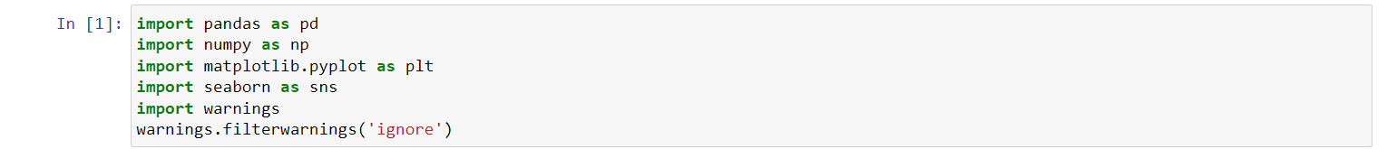
Importing the basic libraries

Slide 4
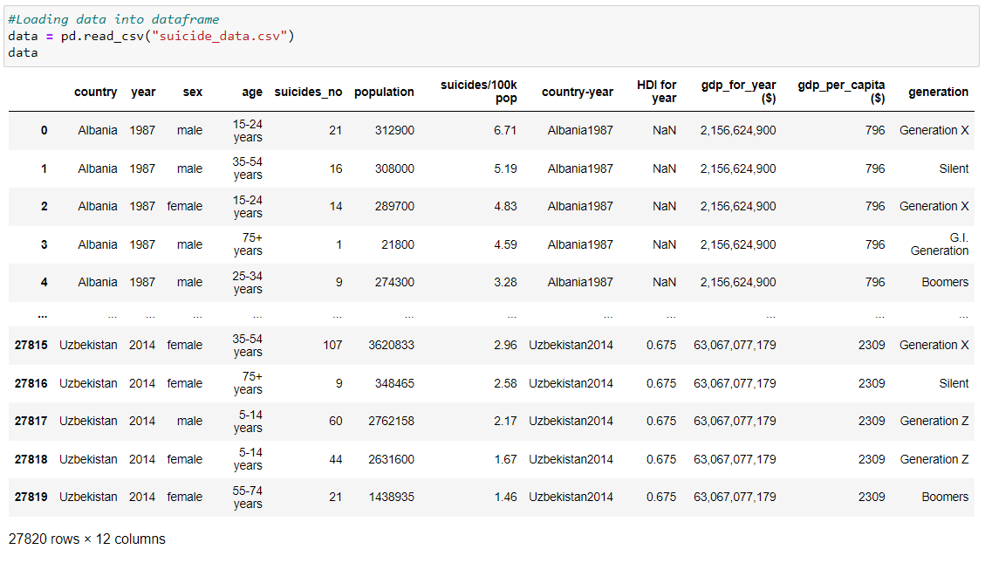
Reading the csv as Dataframe

Slide 5
features description
country = The country where the suicides occurred.
year = The year in which the suicides occurred.
sex = The gender of the individuals involved in the suicides.
age =The age range of the individuals involved in the suicides.
suicides_no = The number of suicides reported.
population = The population of the country during the specified year.
suicides/100k pop = The rate of suicides per population for the specified year.
country-year = A unique identifier combining the country and year.
HDI for year = The Human Development Index (HDI) for the specified year, indicating the level of human development in the country.
gdp_for_year ($) = The Gross Domestic Product (GDP) of the country for the specified year, indicating the total economic output.
gdp_per_capita ($) = The GDP per capita, calculated by dividing the GDP by the population, indicating the economic output per person.
generation = A categorization of individuals based on their age grouping average.

Slide 6
EDA

Slide 7
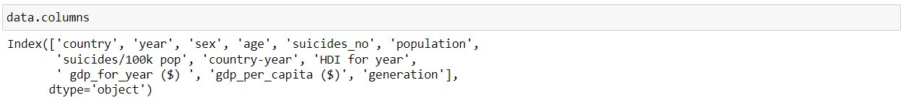
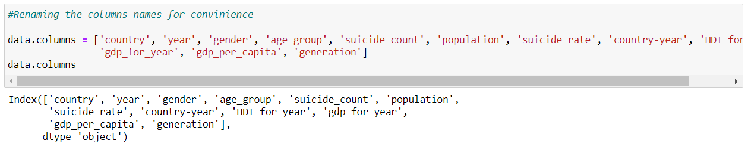
Renaming columns as per convenience

Slide 8
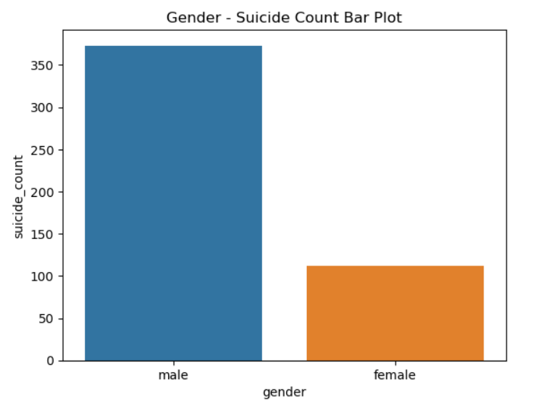
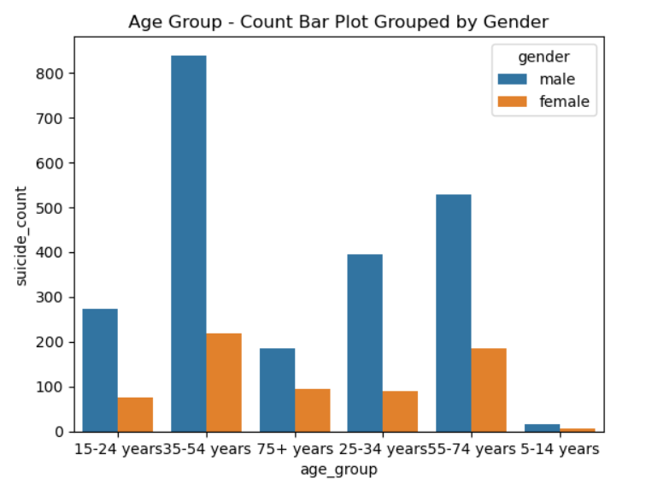
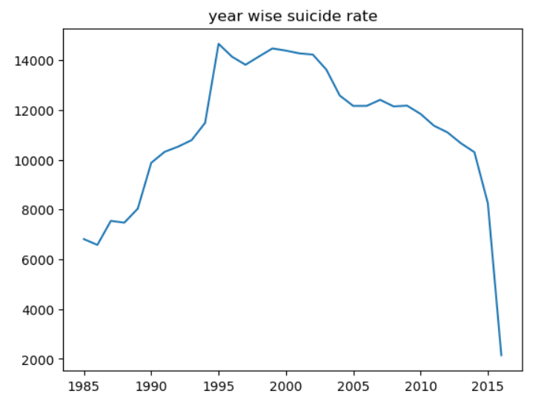
Visualizing the data

Slide 9
insights
Males commit more suicide than that of females.
Peoples from 35 to 54 age group tends to suicide more than the other age groups.
From 1985 to 1995 suicide rates have increased rapidly from 6200 to above 14000 per 100K population
Where as after 1995 the suicide rates started decreasing.
Until 2015 the suicide rate came down around 2000 suicides per 100k population.

Slide 10
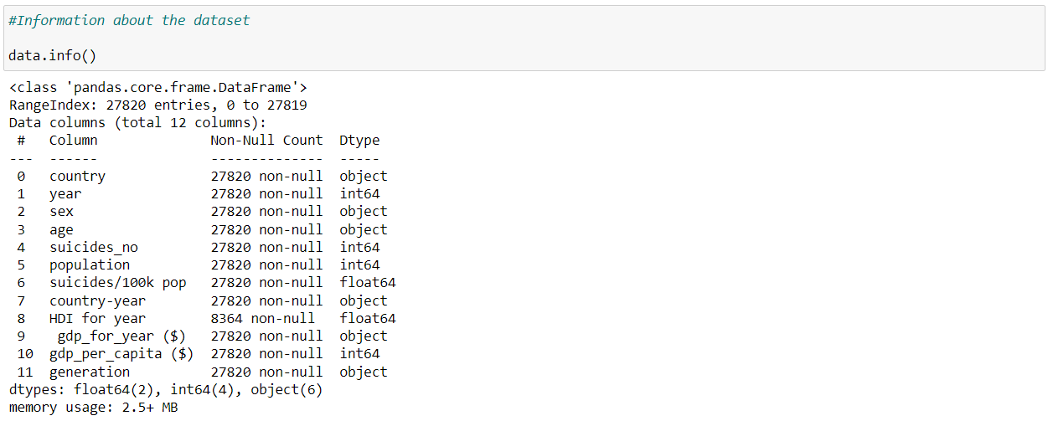
Information about the DataFrame

Slide 11
Observations
Dropping the HDI column from DataFrame as HDI has most of null values compared to total number of rows.
We have Age group column so dropping generation column.
Dropping country year column as country and year columns are present separately.
Country ,Gender ,Age_group and Gdp_for_year columns should be converted to numerical columns.
Scaling all the numerical columns.

Slide 12
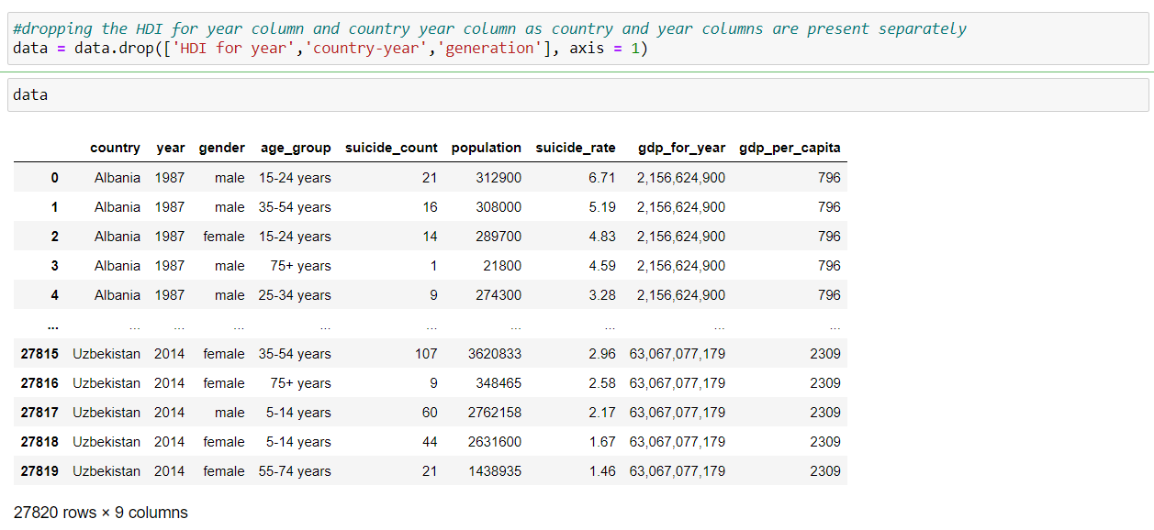
Dropping the columns

Slide 13
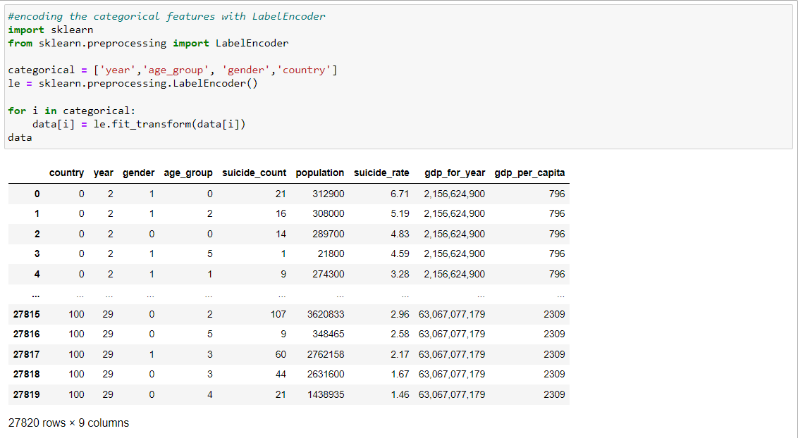
Encoding the data

Slide 14
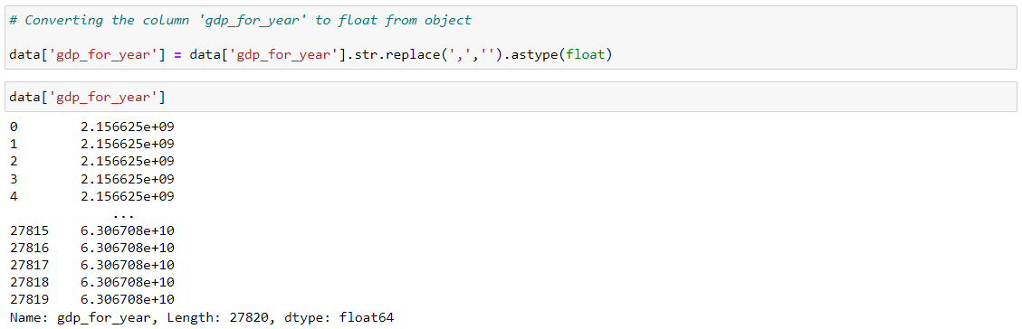

Slide 15
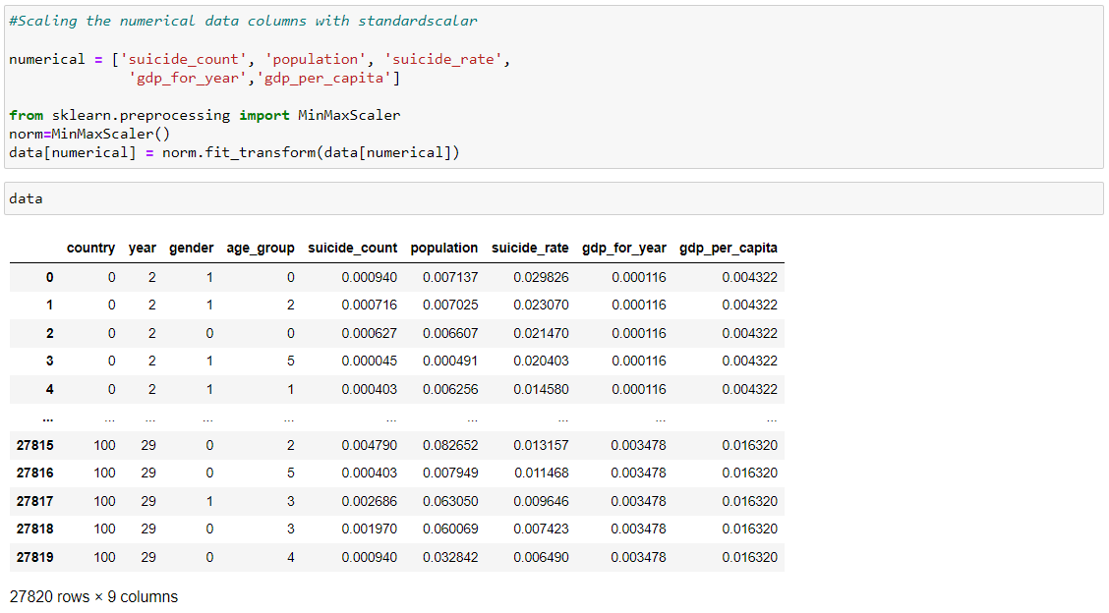
Scaling the numeric columns

Slide 16
As now the data is converted and EDA is done moving to Machine learning

Slide 17
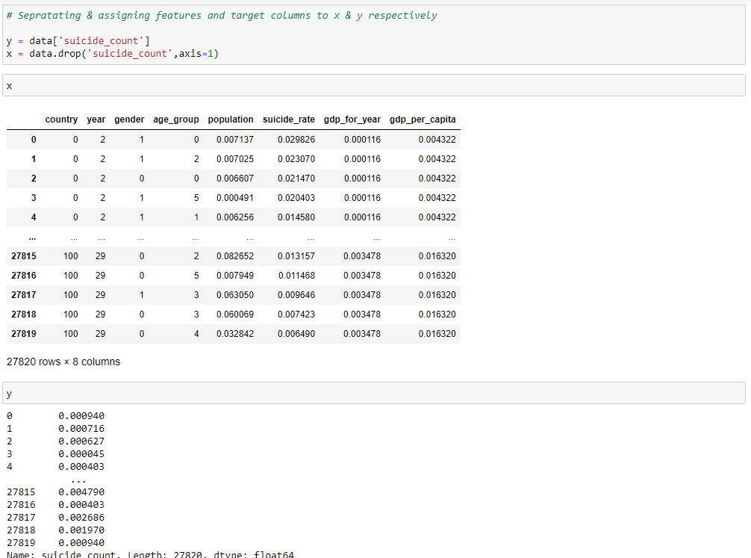
Dividing the DataFrame into x and y

Slide 18
Splitting dataset in test and train

Slide 19
Model Building & Training
We build a machine learning model from features-label pairs, which comprise our training set. Our goal is to make accurate predictions for new, never-before-seen data.
There are two major types of supervised machine learning problems, called classification and regression. Our data set comes under regression problem, as the prediction of suicide count is a continuous number or a floating-point number in programming terms.
The supervised machine learning models (regression) considered to train the dataset in this notebook are:
Linear Regression
k-Nearest Neighbors Regression
Decision Tree
Random Forest
Gradient boost
XG boost
The metrics considered to evaluate the model performance are Accuracy & Root Mean Squared Error.

Slide 20
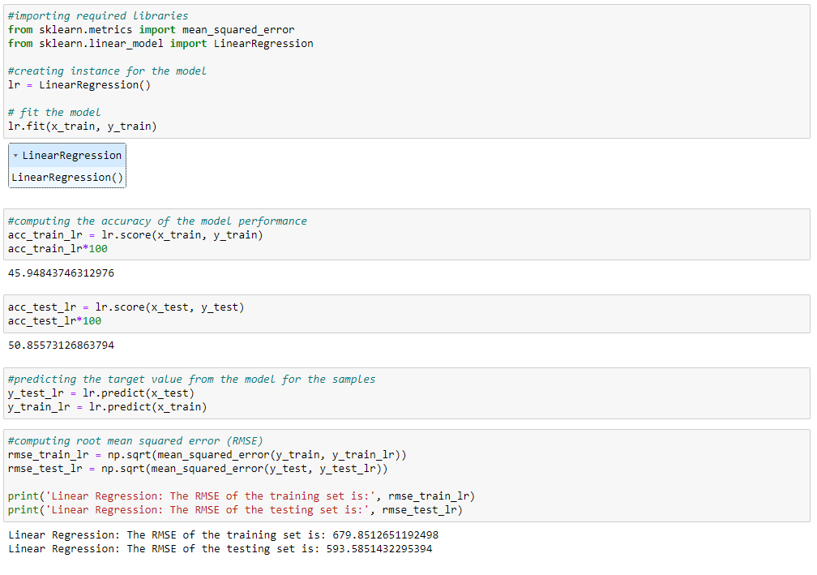
Linear regression

Slide 21
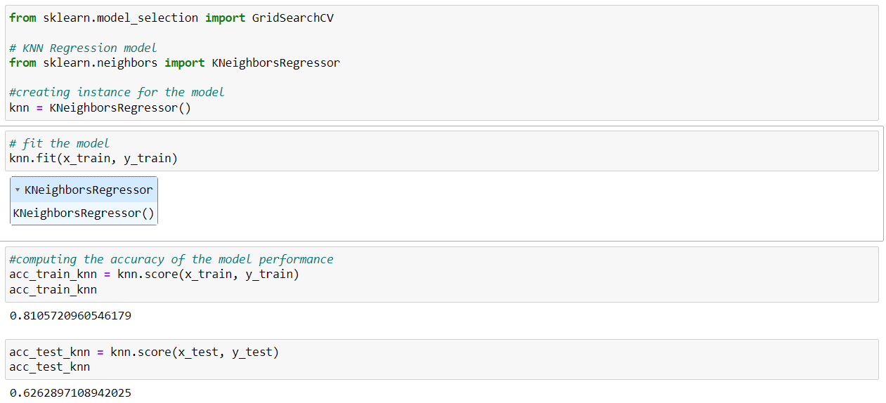
K-nearest neighbor

Slide 22
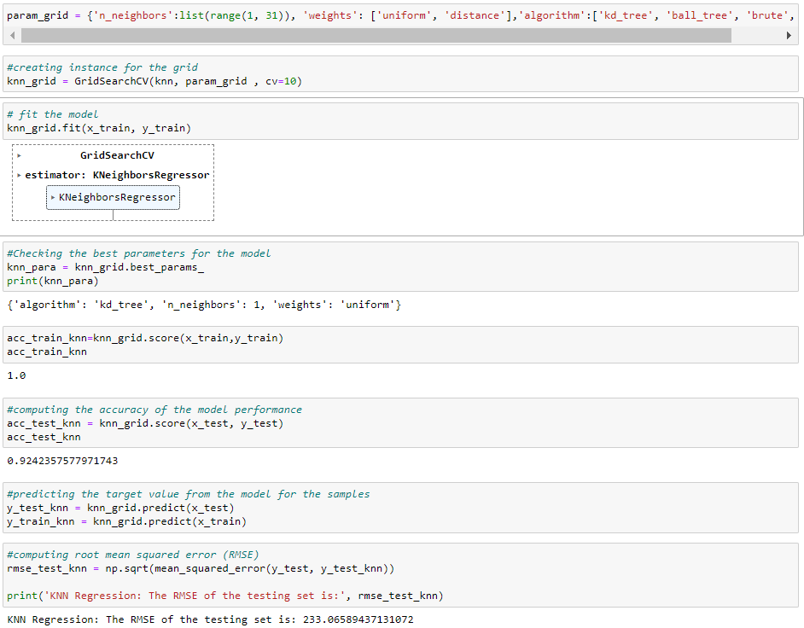
tuning K-nearest neighbor

Slide 23
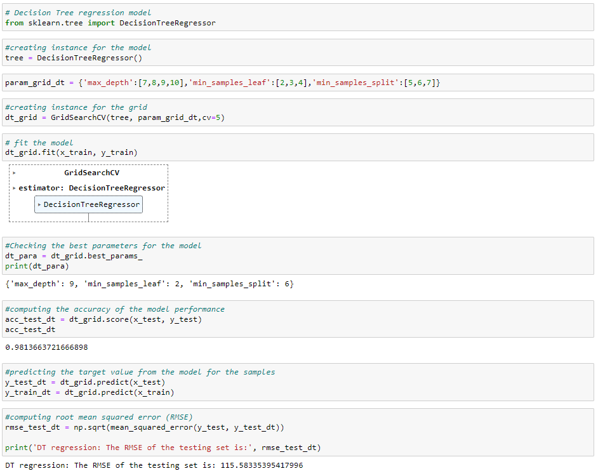
Decision tree regressor with pruning

Slide 24
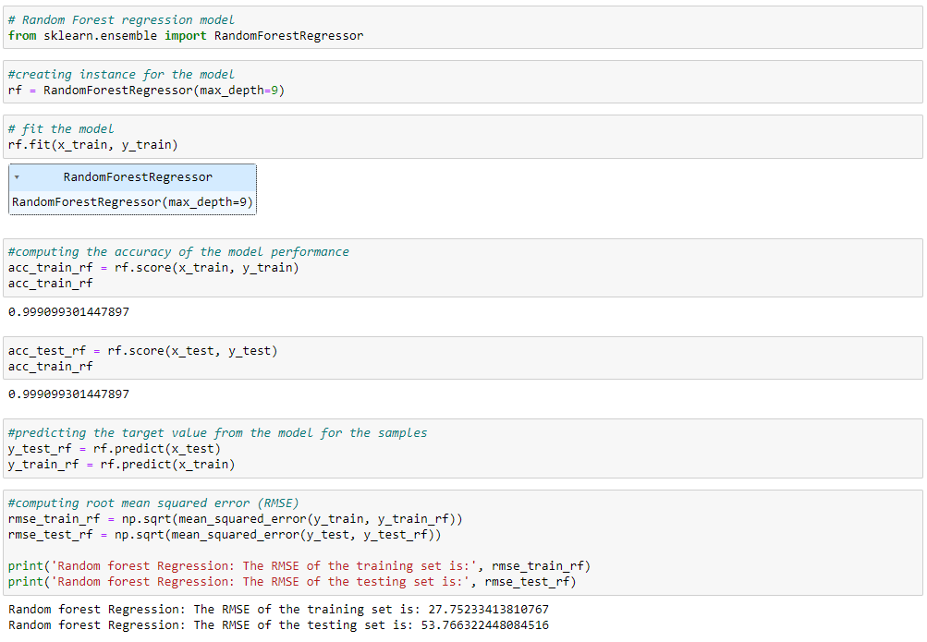
Random forest

Slide 25
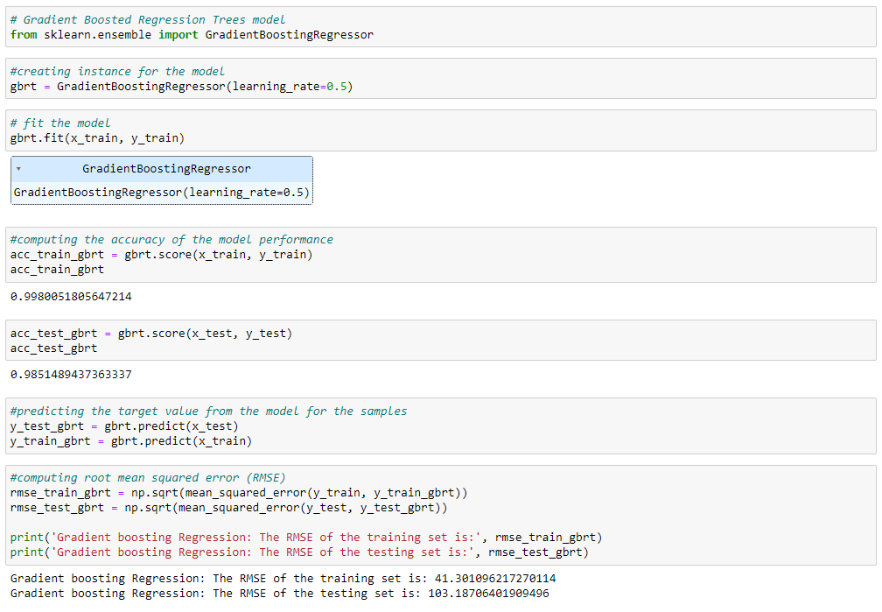
Gradient boosting regression

Slide 26
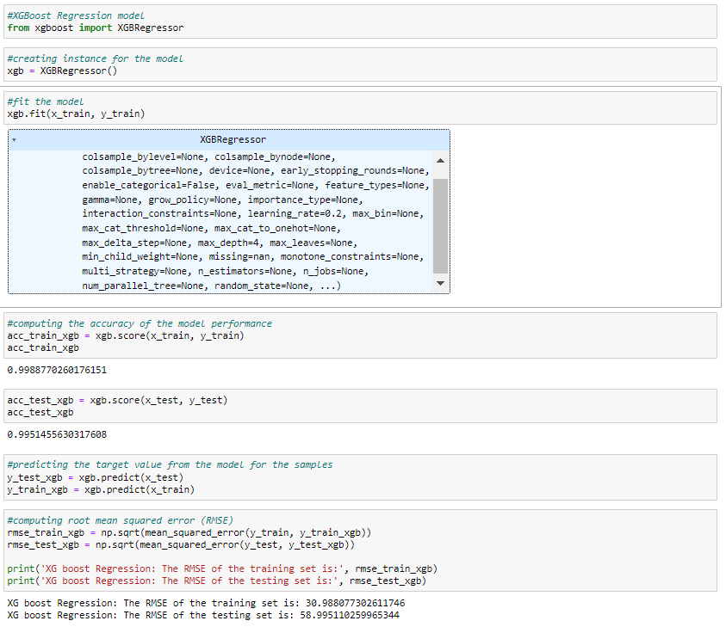
Xgboost regression

Slide 27
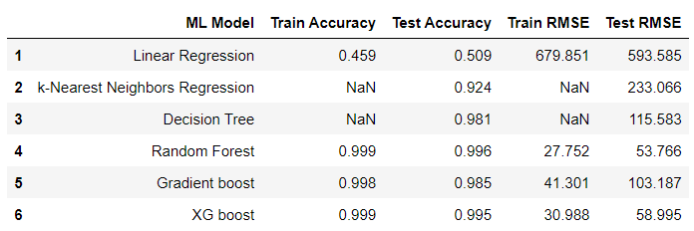
Evaluating the model performance

Slide 28
Conclusion
The final take away form this project is the working of different machine learning models on a dataset and understanding their parameters. Creating this notebook helped me to learn a lot about the parameters of the models, how to tune them and how they affect the model performance.
The final conclusion on the suicide dataset is that Random forest regressor is working exceptionally well with accuracy of 0.996 on the data taken as compared to other models.

Slide 29
Thank you

